Slide 1

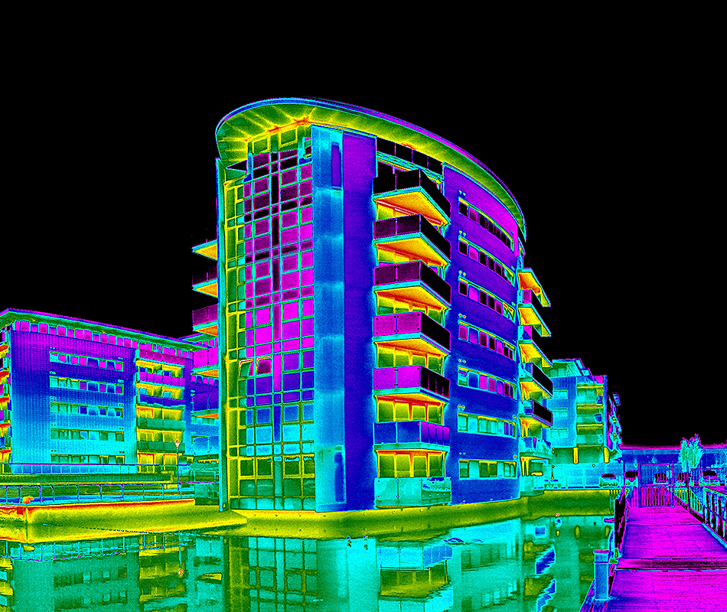

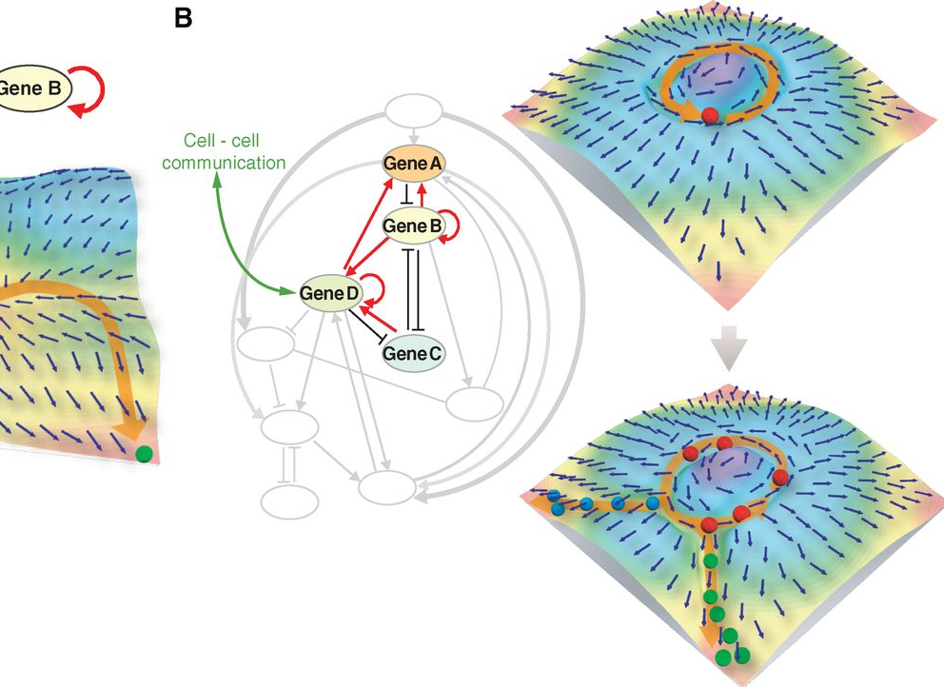

Deep Learning of Dynamics Dynamics of Deep Learning
Ján Drgoňa Collaborators: Aaron Tuor, Elliott Skomski, Soumya Vasisht, Draguna Vrabie
Pacific Northwest National Laboratory
DnC2S meeting January 15, 2021

Slide 2
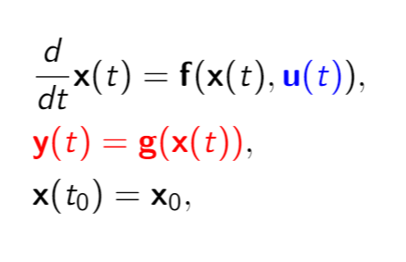
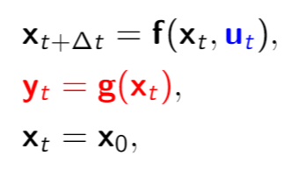
Physics-based Modeling of Dynamical Systems
Differential equations
Difference equations
Discretization methods
Types:
Non-autonomous
Partially observable
Methods:
Euler discretization
Runge Kutta
Linear multistep
Predictor-corrector
Shooting methods
Problems:
Initial value problem
Boundary value problem
Parameter/state estimation
Sensitivity analysis
Optimal control
Issues:
Hard/expensive to obtain
Some are hard to solve
Notes:
Use cases for accurate systems models
Scientific discovery
Support strategic decisions in dynamic environments
Predictive maintenance
Predictive control
Physics-based modeling infeasible for many critical real-world systems
Missing information of underlying system dynamics
Incomplete awareness of model state-space
Limitations on available operational data
Sometimes difficult to get real time simulations
Purely data driven approaches are unsuitable
Poor sampling efficiency due to limited observational data
Black box models lack operational safety guarantees

Slide 3
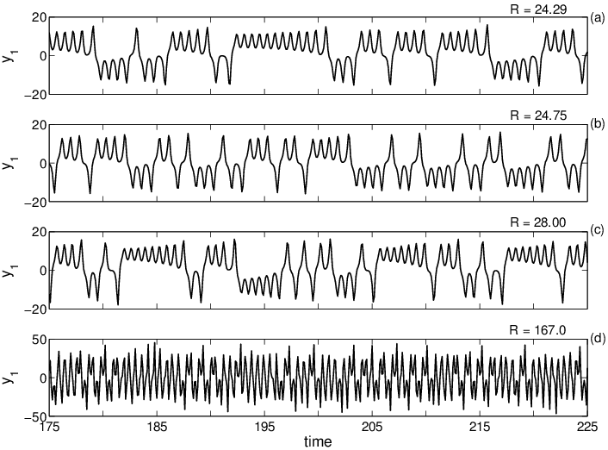
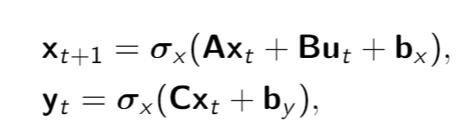
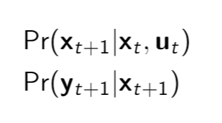
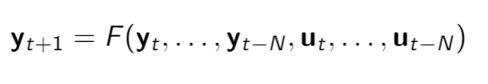
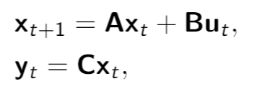
Data-driven Modeling of Dynamical Systems
Time-series data
Difference equations
System identification
Issues:
Data efficiency
Generalization
Accuracy and UQ
Stability and Convergence
State space models
Recurrent neural nets
Markov models
NARX models
Notes:
Use cases for accurate systems models
Scientific discovery
Support strategic decisions in dynamic environments
Predictive maintenance
Predictive control
Physics-based modeling infeasible for many critical real-world systems
Missing information of underlying system dynamics
Incomplete awareness of model state-space
Limitations on available operational data
Sometimes difficult to get real time simulations
Purely data driven approaches are unsuitable
Poor sampling efficiency due to limited observational data
Black box models lack operational safety guarantees

Slide 4
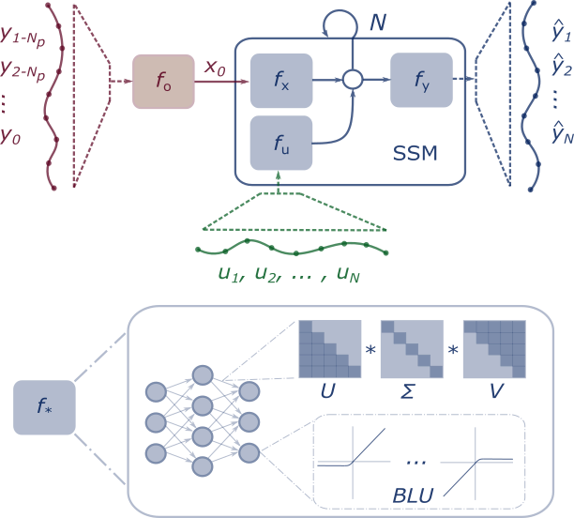
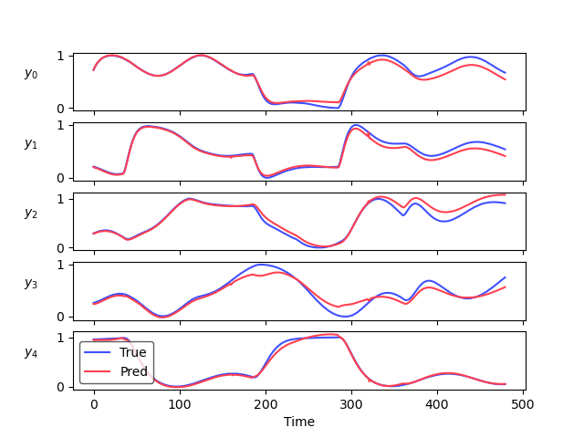
Constrained Deep Neural State Space Models
ML models that respect constraints by
Structured architectures
Penalties as auxiliary loss function terms
Structured linear maps
More structure = improved well-posedness
Elliott Skomski, Jan Drgona, Aaron Tuor Physics-Informed Neural State Space Models via Learning and Evolution, https://arxiv.org/abs/2011.13497
Aaron R Tuor, Ján Drgona, Draguna L Vrabie Constrained Neural Ordinary Differential Equations with Stability Guarantees, https://arxiv.org/abs/2004.10883 Code release: https://github.com/pnnl/neural_ODE_ICLR2020
Notes:
We present a generalized family of neural state space model architectures constrained block-structured nonlinear neural state space models.
Our approach combines the benefits of classical system identification techniques with the advances in constrained deep learning to learn deep structured models.
In particular, we build modular representations of nonlinear systems with identifiable neuralmodules that may be constrained and influenced by structuralpriors. This allows for inclusion of stability constraints through eigenvalue regularizations of the network weights,state and input constraints, and other boundary conditionconstraints.

Slide 5
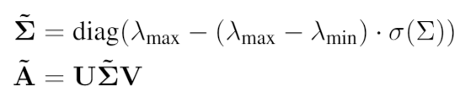
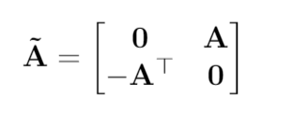
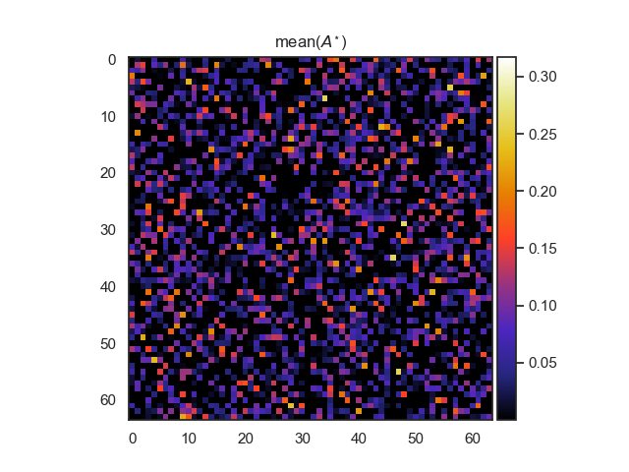
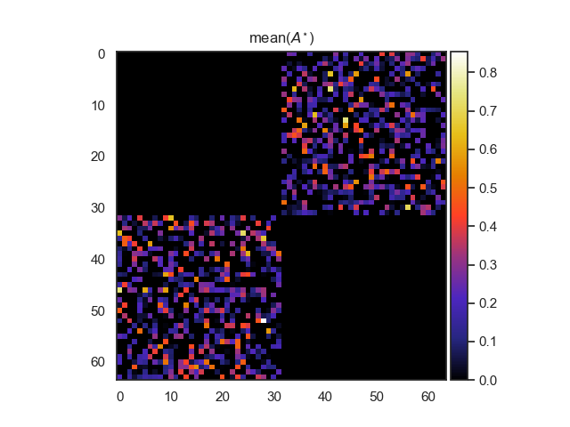
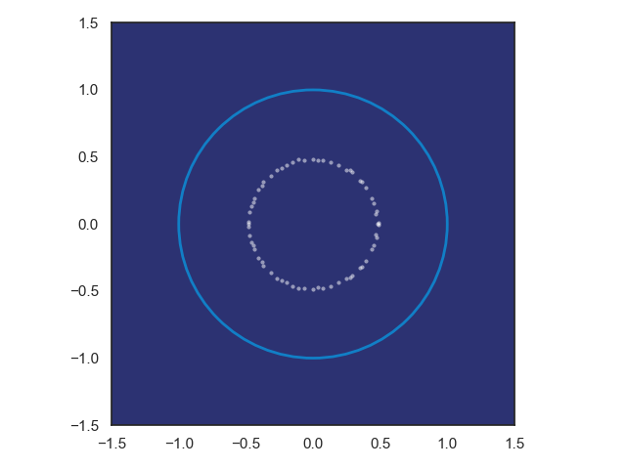
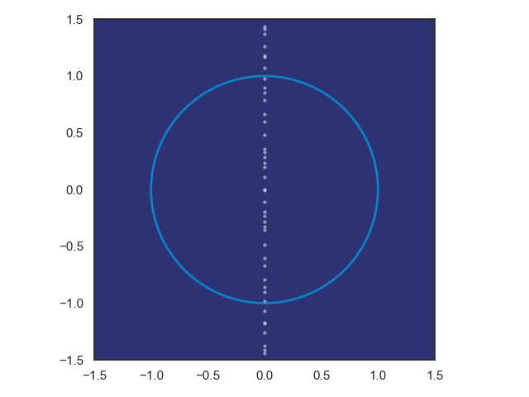
Structured Linear Maps with Eigenvalue Constraints
SVD factorization
Hamiltonian weight
Jiong Zhang, et al., Stabilizing Gradients for Deep Neural Networks via Efficient SVD Parameterization, 2018. Eldad Haber and Lars Ruthotto, Stable Architectures for Deep Neural Networks 2017 Jan Drgona, Aaron Tuor, Soumya Vasisht, Elliott Skomski, Draguna Vrabie, Spectral Analysis and Stability of Deep Neural Dynamics, arXiv:2011.13492

Slide 6
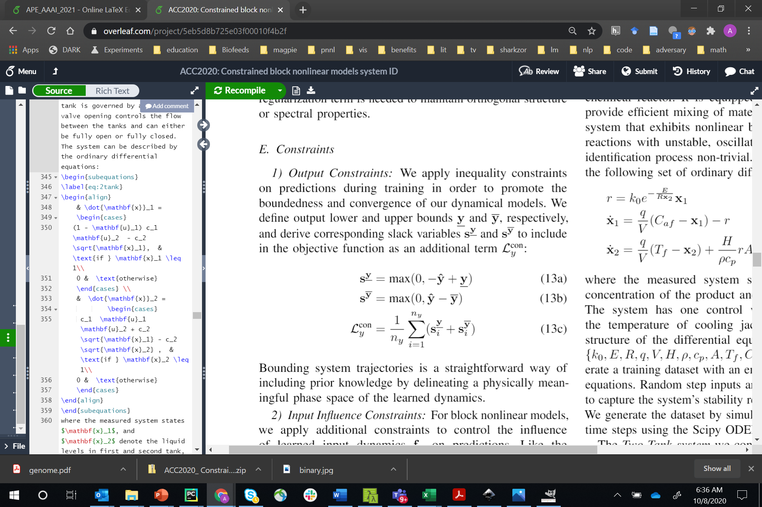
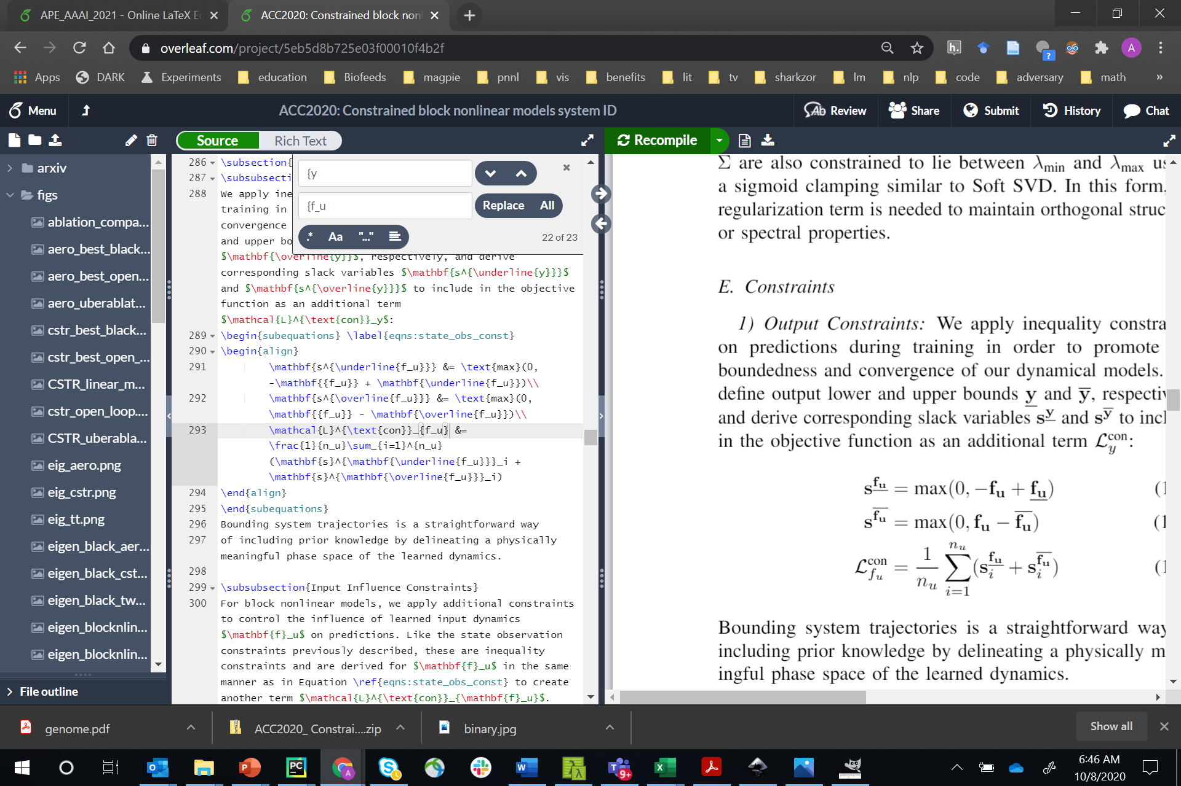
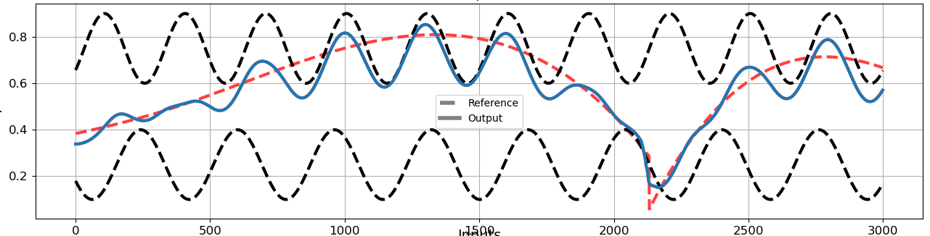
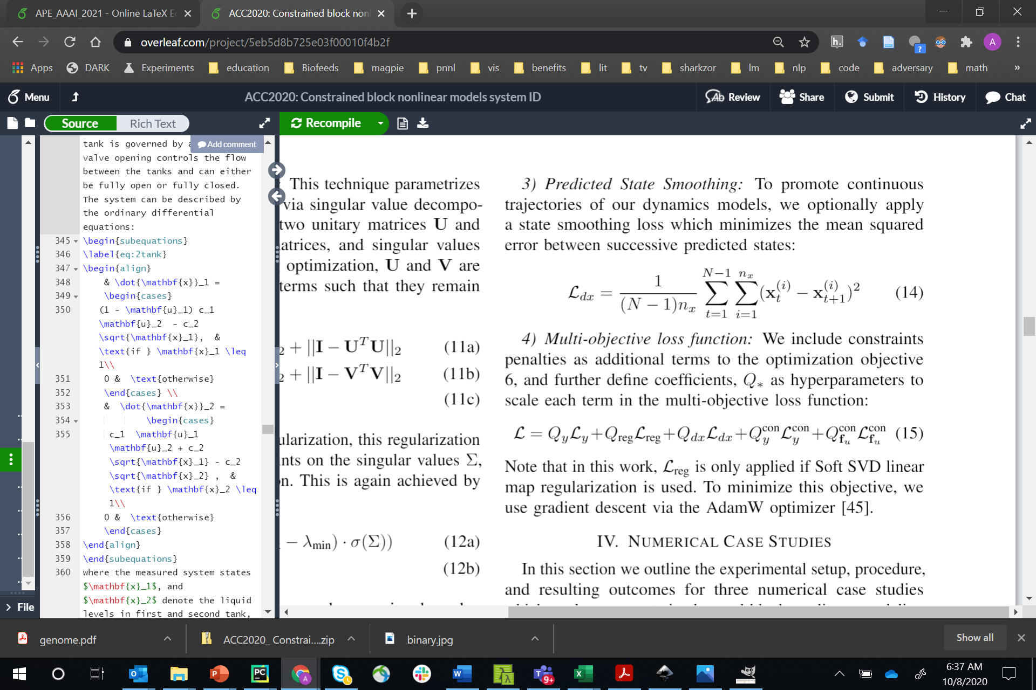
Constraint Penalties
Input dynamics bounds
Output bounds
+
Predicted State Smoothing

Slide 7
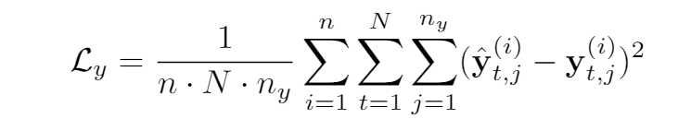
Multi-objective loss term
N-step prediction MSE
Linear map regularization
State smoothing
Input influence constraints
Output constraints

Slide 8
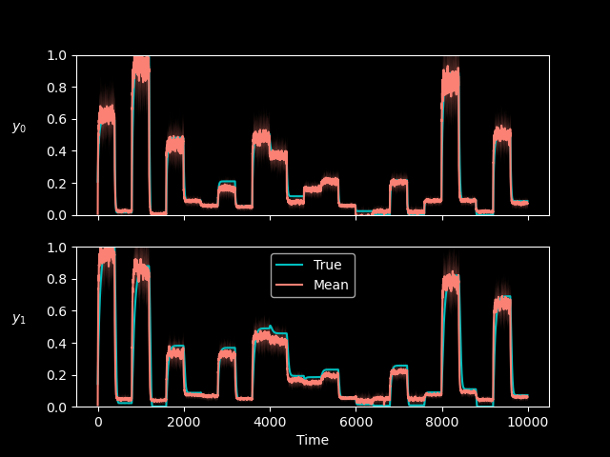
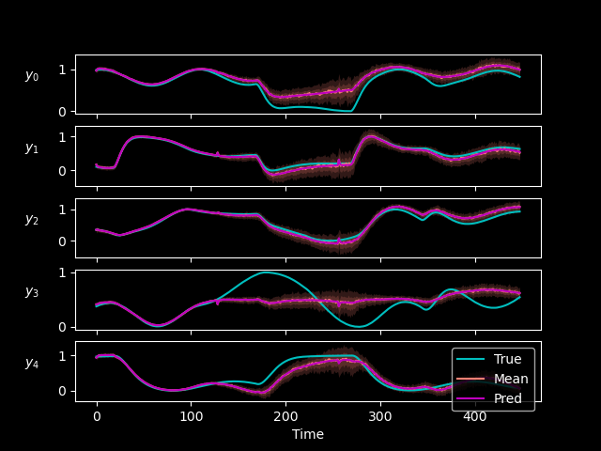
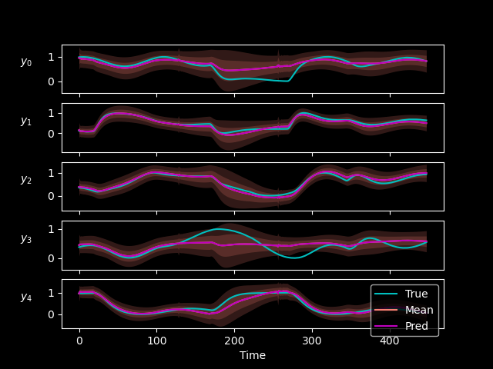
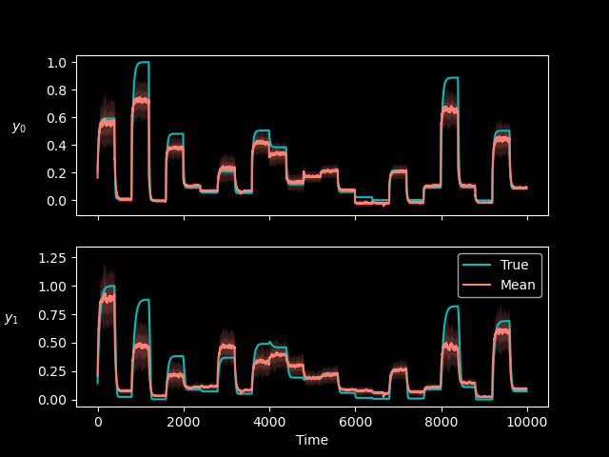
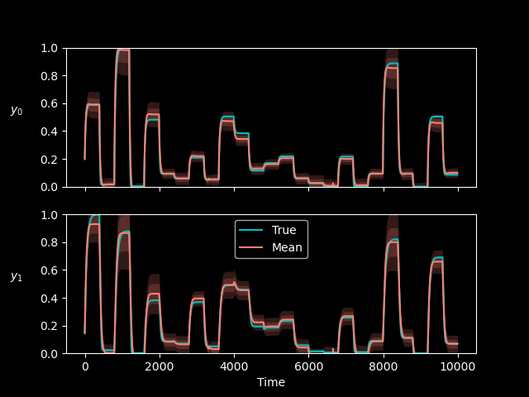
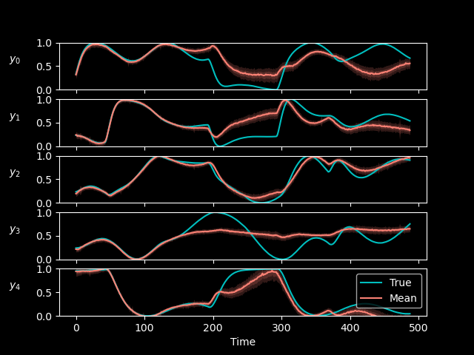
Uncertainty Quantification for Deep Neural State Space Models
Monte-Carlo Dropout
Ensembling
BNN
Preliminary results show correlation between uncertainty estimate and prediction error

Slide 9
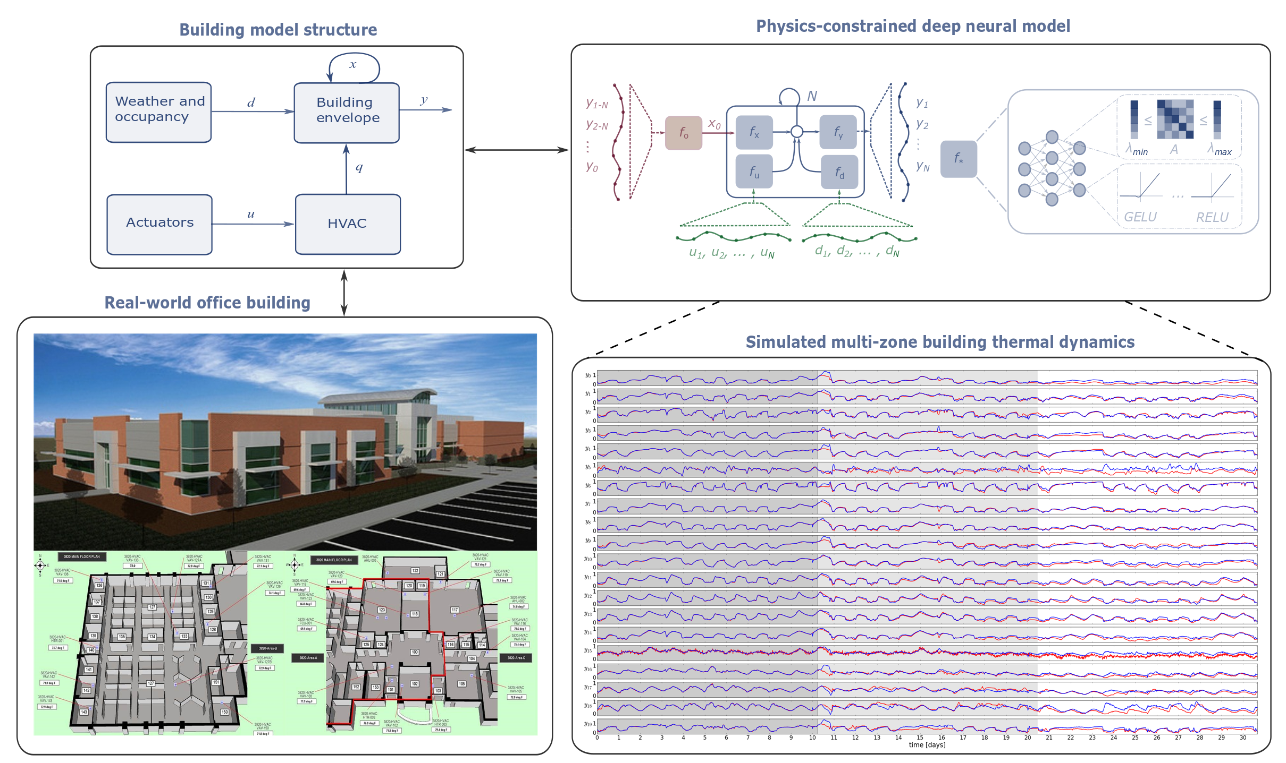
Application: Learning Thermal Dynamics of Multi-zone Building
Jan Drgona, Aaron R. Tuor, Vikas Chandan, Draguna L. Vrabie, Physics-constrained Deep Learning of Multi-zone Building Thermal Dynamics, CCAI Workshop NeurIPS 2020, https://arxiv.org/abs/2011.05987

Slide 10
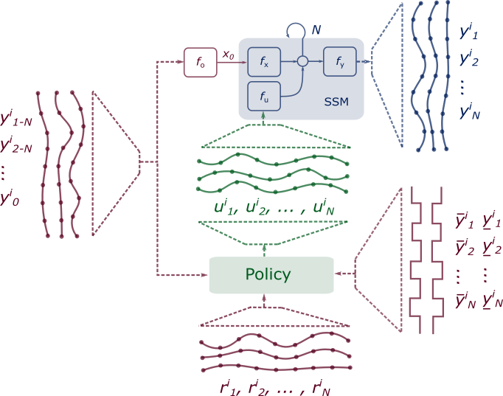
Differentiable Predictive Control of Unknown Dynamical Systems
Step 1: System identification
Step 2: Policy optimization by model differentiation
Notes:
Use cases for accurate systems models
Scientific discovery
Support strategic decisions in dynamic environments
Predictive maintenance
Predictive control
Physics-based modeling infeasible for many critical real-world systems
Missing information of underlying system dynamics
Incomplete awareness of model state-space
Limitations on available operational data
Sometimes difficult to get real time simulations
Purely data driven approaches are unsuitable
Poor sampling efficiency due to limited observational data
Black box models lack operational safety guarantees

Slide 11
Connections of DPC with Model Predictive Control
Formulation of MPC problem as a constrained deep learning model
Jan Drgona, Aaron Tuor, Draguna Vrabie, Constrained Physics-Informed Deep Learning for Stable System Identification and Control of Linear Systems, Code release: https://github.com/pnnl/deps_arXiv2020

Slide 12
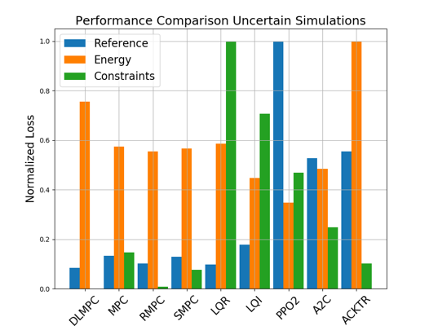
Physics Informed DPC of Unknown Linear System
Closed loop trajectories. Top: controlled state (orange), internal model predictions (blue), given reference (dashed blue), and constraints (dashed black). Middle: control action (blue) and bounds (dashed black). Bottom: disturbances
Control performance comparison in simulations with parametric and additive uncertainties. Control Strategies: MPC, Robust MPC , Stochastic MPC, LQR, LQI, A2C: Asynchronous, deterministic variant of Advantage Actor Critic, ACKTR: Actor Critic using Kronecker-Factored Trust Region, PPO2: Proximal Policy Optimization
Jan Drgona, Aaron Tuor, Draguna Vrabie, Constrained Physics-Informed Deep Learning for Stable System Identification and Control of Linear Systems, Code release: https://github.com/pnnl/deps_arXiv2020

Slide 13
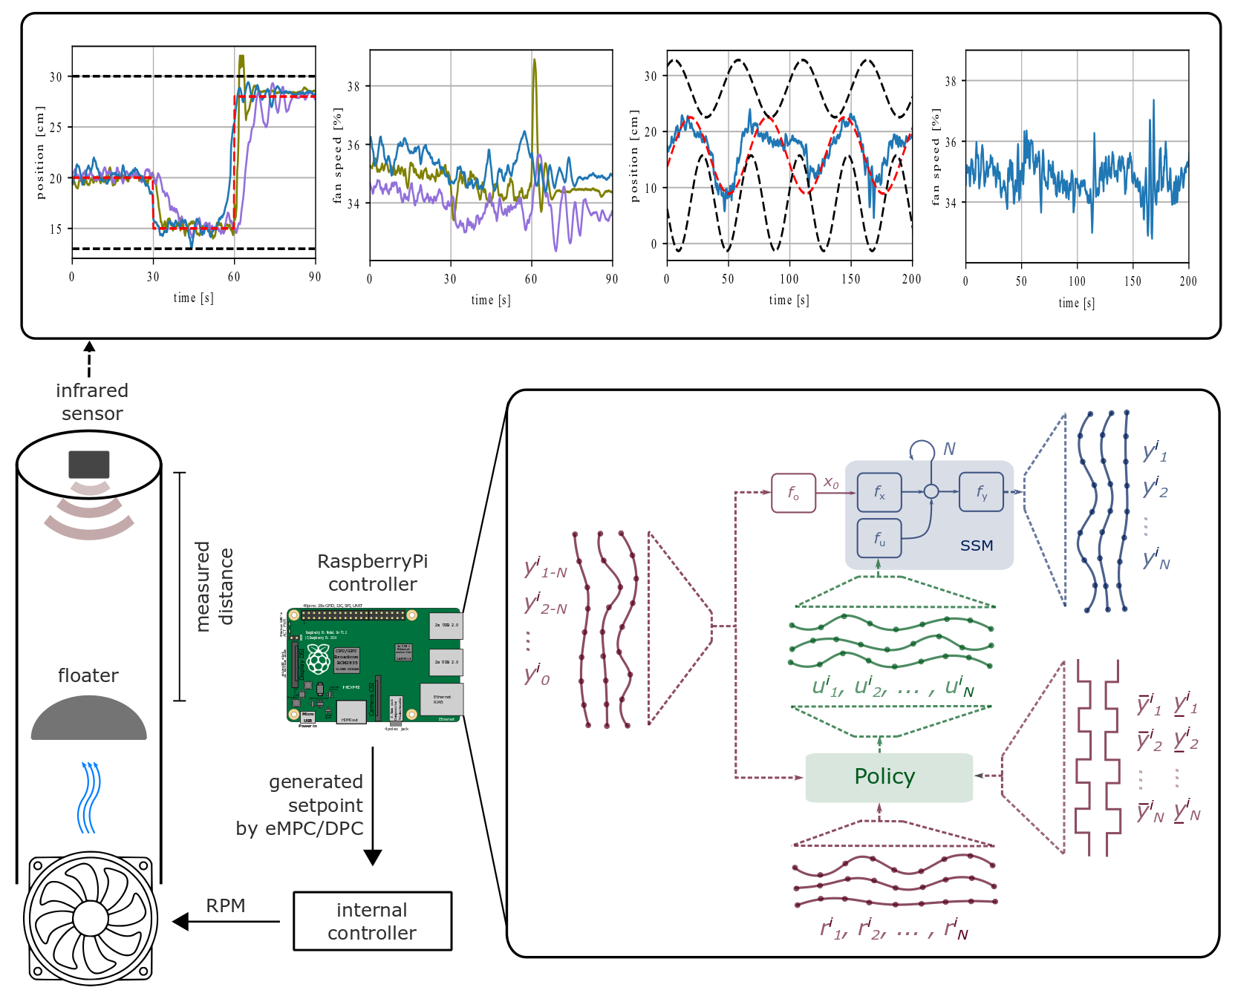
DPC of a Real Unknown Nonlinear System
Solution of optimal control problems for unknown nonlinear systems​
Constrained model-based neural policies with physically plausible outcomes​
Tracking dynamic references and avoiding dynamic constraints
Real-time control application on an embedded hardware​
Favorable control performance and scalability comparison with MPC​
Energy Data Analytics Symposium
Jan Drgona, Karol Kis, Aaron Tuor, Draguna Vrabie, Martin Klauco,
Differentiable Predictive Control: An MPC Alternative for Unknown Nonlinear Systems using Constrained Deep Learning, preprint, 2020​ https://arxiv.org/abs/2011.03699​

Slide 14
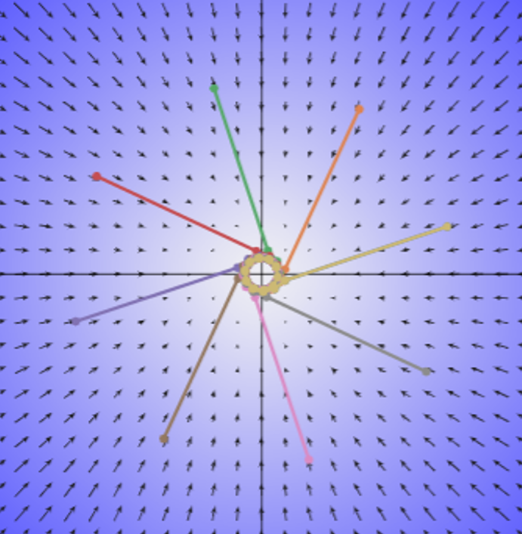
Dynamical Analysis of Deep Neural Networks

Slide 15
Dynamical Analysis of Deep Neural Networks
Motivation
Safety-critical and high-performance systems call for formal verification methods to ensure safe operation.
Lack of guarantees on global and local behavior of DNNs still remain limiting factors.
Properties like stability and robustness are crucial for reliable system identification and control.
Goal
Apply system- and control-theoretic analysis methods on DNNs.
Provide stability guarantees, identify state space regions and achieve desired dynamical behavior with DNNs.
Notes:
The presentation I’m giving today is for a data-driven method for dynamics modeling.
We should care about this because people interact with and depend on complicated systems all the time.
Greater understanding of these systems can lead to outcomes which are
More energy efficient
Cost effective
Conducive to human life
Having an accurate model of a system enables scientific discovery,
Can provide critical information to support high stakes decisions in changing environments
Or to provide necessary information for predictive maintenance of high value equipment, avoiding costly and potentially dangerous equipment
Failures.
One of the most common and lucrative uses of systems models are for predictive control in manufacturing and other large scale enterprises.
I’m presenting a method today which bridges benefits of traditional physics-based modeling with more recent data-driven modeling using deep learning
Traditional physics-based modeling works very well and is widely used in many real world applications. However, it can’t always be applied to every situation.
missing information
incomplete awareness of the model state space.
limitations on the available operational data.
For large scale systems, not only are they difficult to model from first principles, it is also not always possible to simulate the system in real time.
Data-driven approaches for systems modeling are an alternative in these situations but can come with their own disadvantages.
Can take a lot of data to train and may behave unpredictably outside the distribution of training data in unobserved regions of the system state space.
In addition, modern neural network approaches don’t typically provide constraints enforcement within physically realizable and operationally safe bounds,

Slide 16

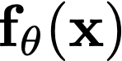


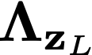
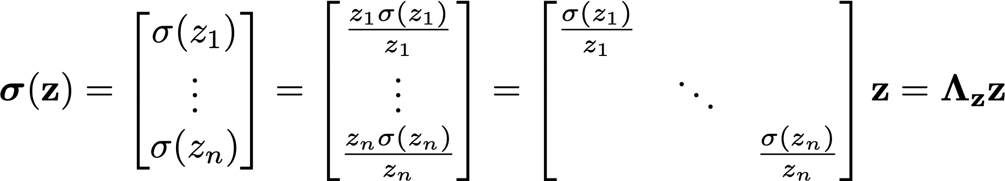
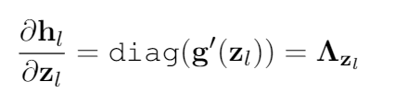
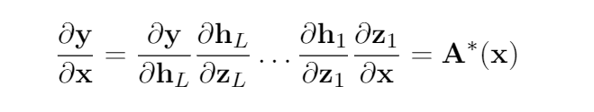
Spectral Analysis and Stability of Deep Neural Networks
Novel characterization that views deep neural networks (DNNs) from a dynamical systems perspective.
Jacobians of DNNs as pointwise parameter-varying affine maps.
At every point , the neural network, may be represented as
where represent the weight parameterizations at layer , and is a diagonal matrix that represents the element-wise application of the nonlinear activation function at layer .
Jan Drgona, Aaron Tuor, Soumya Vasisht, Elliott Skomski, Draguna Vrabie, Spectral Analysis and Stability of Deep Neural Dynamics.
Notes:
The presentation I’m giving today is for a data-driven method for dynamics modeling.
We should care about this because people interact with and depend on complicated systems all the time.
Greater understanding of these systems can lead to outcomes which are
More energy efficient
Cost effective
Conducive to human life
Having an accurate model of a system enables scientific discovery,
Can provide critical information to support high stakes decisions in changing environments
Or to provide necessary information for predictive maintenance of high value equipment, avoiding costly and potentially dangerous equipment
Failures.
One of the most common and lucrative uses of systems models are for predictive control in manufacturing and other large scale enterprises.
I’m presenting a method today which bridges benefits of traditional physics-based modeling with more recent data-driven modeling using deep learning
Traditional physics-based modeling works very well and is widely used in many real world applications. However, it can’t always be applied to every situation.
missing information
incomplete awareness of the model state space.
limitations on the available operational data.
For large scale systems, not only are they difficult to model from first principles, it is also not always possible to simulate the system in real time.
Data-driven approaches for systems modeling are an alternative in these situations but can come with their own disadvantages.
Can take a lot of data to train and may behave unpredictably outside the distribution of training data in unobserved regions of the system state space.
In addition, modern neural network approaches don’t typically provide constraints enforcement within physically realizable and operationally safe bounds,

Slide 17
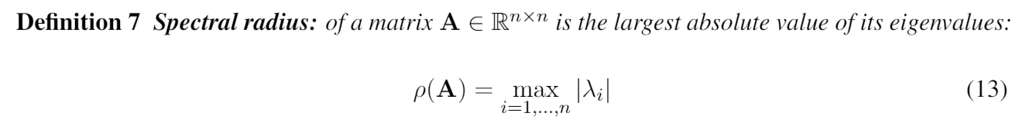
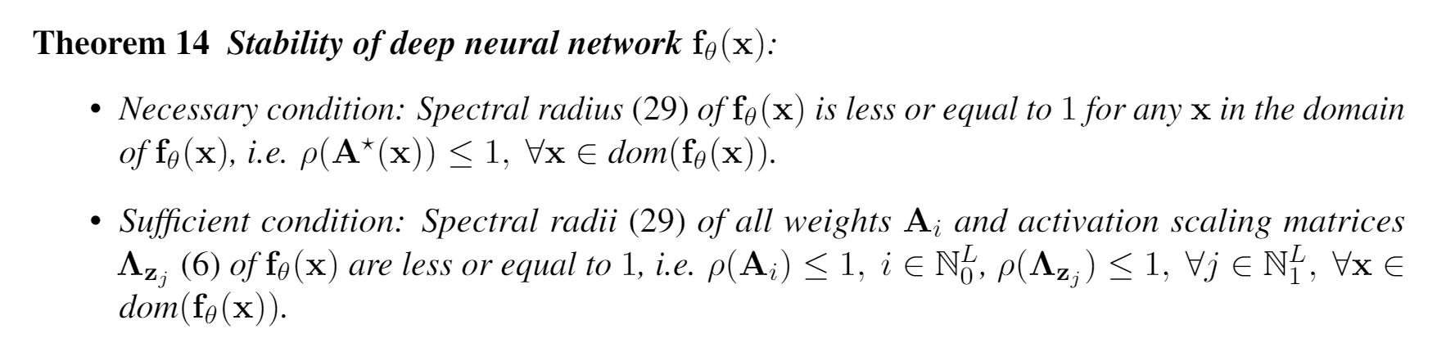
Stability Theorem for Deep Neural Networks
Jan Drgona, Aaron Tuor, Soumya Vasisht, Elliott Skomski, Draguna Vrabie, Spectral Analysis and Stability of Deep Neural Dynamics, arXiv:2011.13492
Notes:
The presentation I’m giving today is for a data-driven method for dynamics modeling.
We should care about this because people interact with and depend on complicated systems all the time.
Greater understanding of these systems can lead to outcomes which are
More energy efficient
Cost effective
Conducive to human life
Having an accurate model of a system enables scientific discovery,
Can provide critical information to support high stakes decisions in changing environments
Or to provide necessary information for predictive maintenance of high value equipment, avoiding costly and potentially dangerous equipment
Failures.
One of the most common and lucrative uses of systems models are for predictive control in manufacturing and other large scale enterprises.
I’m presenting a method today which bridges benefits of traditional physics-based modeling with more recent data-driven modeling using deep learning
Traditional physics-based modeling works very well and is widely used in many real world applications. However, it can’t always be applied to every situation.
missing information
incomplete awareness of the model state space.
limitations on the available operational data.
For large scale systems, not only are they difficult to model from first principles, it is also not always possible to simulate the system in real time.
Data-driven approaches for systems modeling are an alternative in these situations but can come with their own disadvantages.
Can take a lot of data to train and may behave unpredictably outside the distribution of training data in unobserved regions of the system state space.
In addition, modern neural network approaches don’t typically provide constraints enforcement within physically realizable and operationally safe bounds,

Slide 18
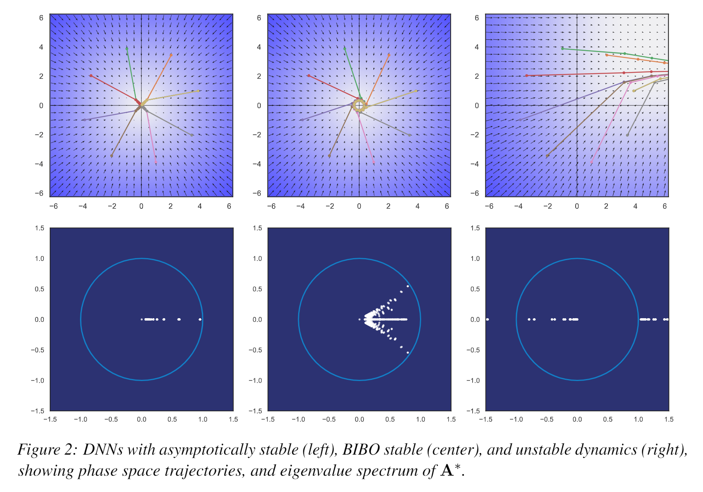
Dynamical Effects of Weights
Jan Drgona, Aaron Tuor, Soumya Vasisht, Elliott Skomski, Draguna Vrabie, Spectral Analysis and Stability of Deep Neural Dynamics, arXiv:2011.13492
Notes:
The presentation I’m giving today is for a data-driven method for dynamics modeling.
We should care about this because people interact with and depend on complicated systems all the time.
Greater understanding of these systems can lead to outcomes which are
More energy efficient
Cost effective
Conducive to human life
Having an accurate model of a system enables scientific discovery,
Can provide critical information to support high stakes decisions in changing environments
Or to provide necessary information for predictive maintenance of high value equipment, avoiding costly and potentially dangerous equipment
Failures.
One of the most common and lucrative uses of systems models are for predictive control in manufacturing and other large scale enterprises.
I’m presenting a method today which bridges benefits of traditional physics-based modeling with more recent data-driven modeling using deep learning
Traditional physics-based modeling works very well and is widely used in many real world applications. However, it can’t always be applied to every situation.
missing information
incomplete awareness of the model state space.
limitations on the available operational data.
For large scale systems, not only are they difficult to model from first principles, it is also not always possible to simulate the system in real time.
Data-driven approaches for systems modeling are an alternative in these situations but can come with their own disadvantages.
Can take a lot of data to train and may behave unpredictably outside the distribution of training data in unobserved regions of the system state space.
In addition, modern neural network approaches don’t typically provide constraints enforcement within physically realizable and operationally safe bounds,

Slide 19
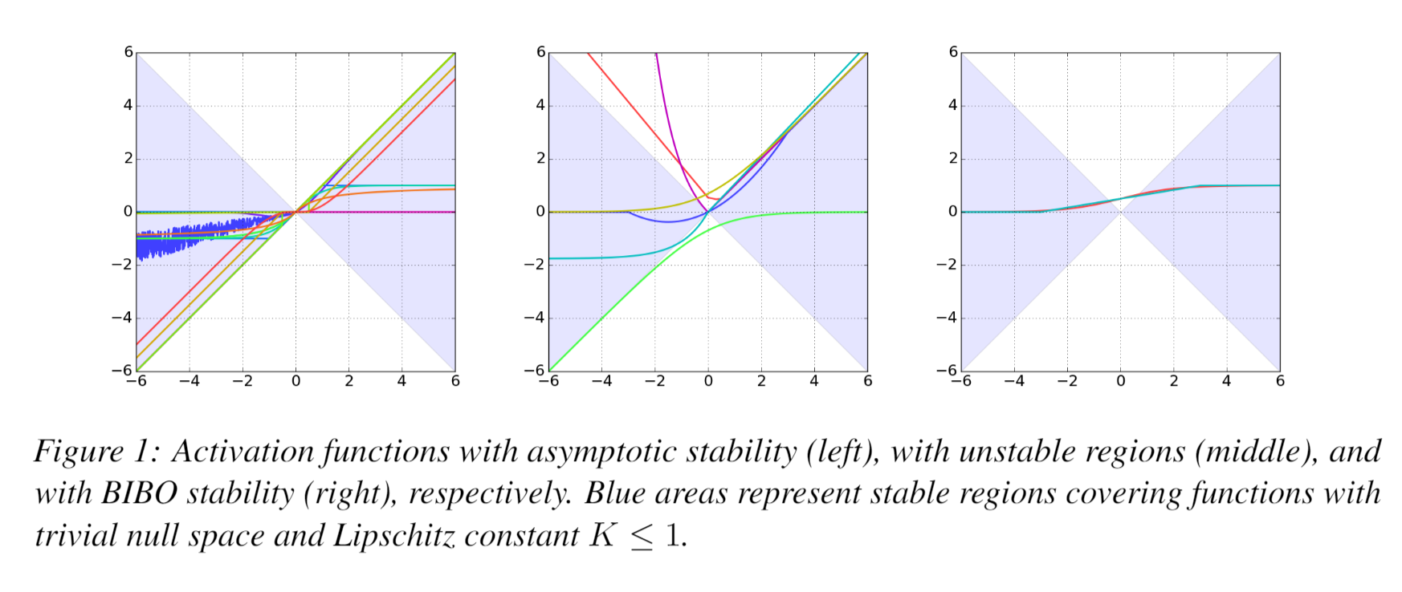
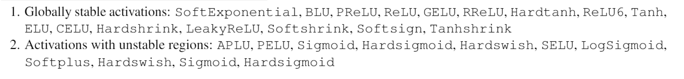
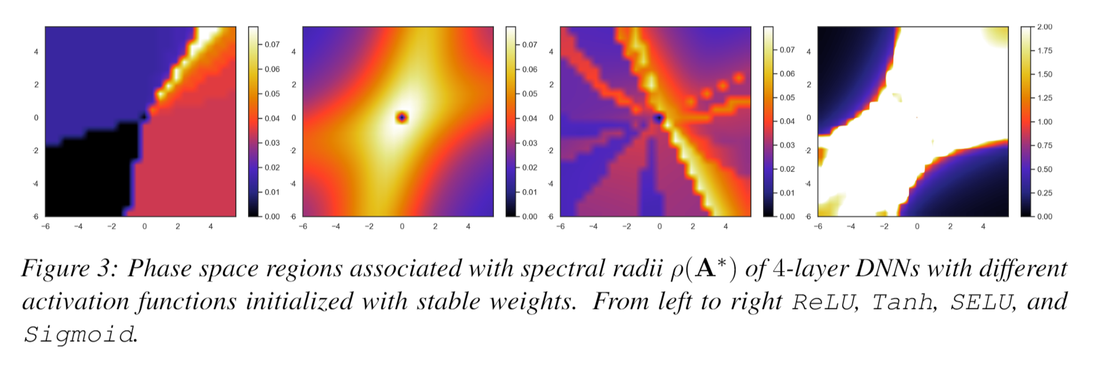
Dynamical Effects of Activation Functions
Jan Drgona, Aaron Tuor, Soumya Vasisht, Elliott Skomski, Draguna Vrabie, Spectral Analysis and Stability of Deep Neural Dynamics, arXiv:2011.13492
Notes:
The presentation I’m giving today is for a data-driven method for dynamics modeling.
We should care about this because people interact with and depend on complicated systems all the time.
Greater understanding of these systems can lead to outcomes which are
More energy efficient
Cost effective
Conducive to human life
Having an accurate model of a system enables scientific discovery,
Can provide critical information to support high stakes decisions in changing environments
Or to provide necessary information for predictive maintenance of high value equipment, avoiding costly and potentially dangerous equipment
Failures.
One of the most common and lucrative uses of systems models are for predictive control in manufacturing and other large scale enterprises.
I’m presenting a method today which bridges benefits of traditional physics-based modeling with more recent data-driven modeling using deep learning
Traditional physics-based modeling works very well and is widely used in many real world applications. However, it can’t always be applied to every situation.
missing information
incomplete awareness of the model state space.
limitations on the available operational data.
For large scale systems, not only are they difficult to model from first principles, it is also not always possible to simulate the system in real time.
Data-driven approaches for systems modeling are an alternative in these situations but can come with their own disadvantages.
Can take a lot of data to train and may behave unpredictably outside the distribution of training data in unobserved regions of the system state space.
In addition, modern neural network approaches don’t typically provide constraints enforcement within physically realizable and operationally safe bounds,

Slide 20
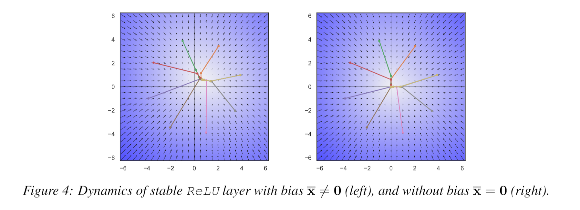
Dynamical Effects of Bias Terms
Bias terms in generic DNNs do not affect the dynamical properties such as eigenvalues, stability, or convergence. Instead, biases uniquely define the centroid of attractors confined in the compact subspace of the state space. Therefore, we posit that dynamical properties are uniquely defined by the network’s weights and activation functions.
Jan Drgona, Aaron Tuor, Soumya Vasisht, Elliott Skomski, Draguna Vrabie, Spectral Analysis and Stability of Deep Neural Dynamics, arXiv:2011.13492
Notes:
The presentation I’m giving today is for a data-driven method for dynamics modeling.
We should care about this because people interact with and depend on complicated systems all the time.
Greater understanding of these systems can lead to outcomes which are
More energy efficient
Cost effective
Conducive to human life
Having an accurate model of a system enables scientific discovery,
Can provide critical information to support high stakes decisions in changing environments
Or to provide necessary information for predictive maintenance of high value equipment, avoiding costly and potentially dangerous equipment
Failures.
One of the most common and lucrative uses of systems models are for predictive control in manufacturing and other large scale enterprises.
I’m presenting a method today which bridges benefits of traditional physics-based modeling with more recent data-driven modeling using deep learning
Traditional physics-based modeling works very well and is widely used in many real world applications. However, it can’t always be applied to every situation.
missing information
incomplete awareness of the model state space.
limitations on the available operational data.
For large scale systems, not only are they difficult to model from first principles, it is also not always possible to simulate the system in real time.
Data-driven approaches for systems modeling are an alternative in these situations but can come with their own disadvantages.
Can take a lot of data to train and may behave unpredictably outside the distribution of training data in unobserved regions of the system state space.
In addition, modern neural network approaches don’t typically provide constraints enforcement within physically realizable and operationally safe bounds,

Slide 21
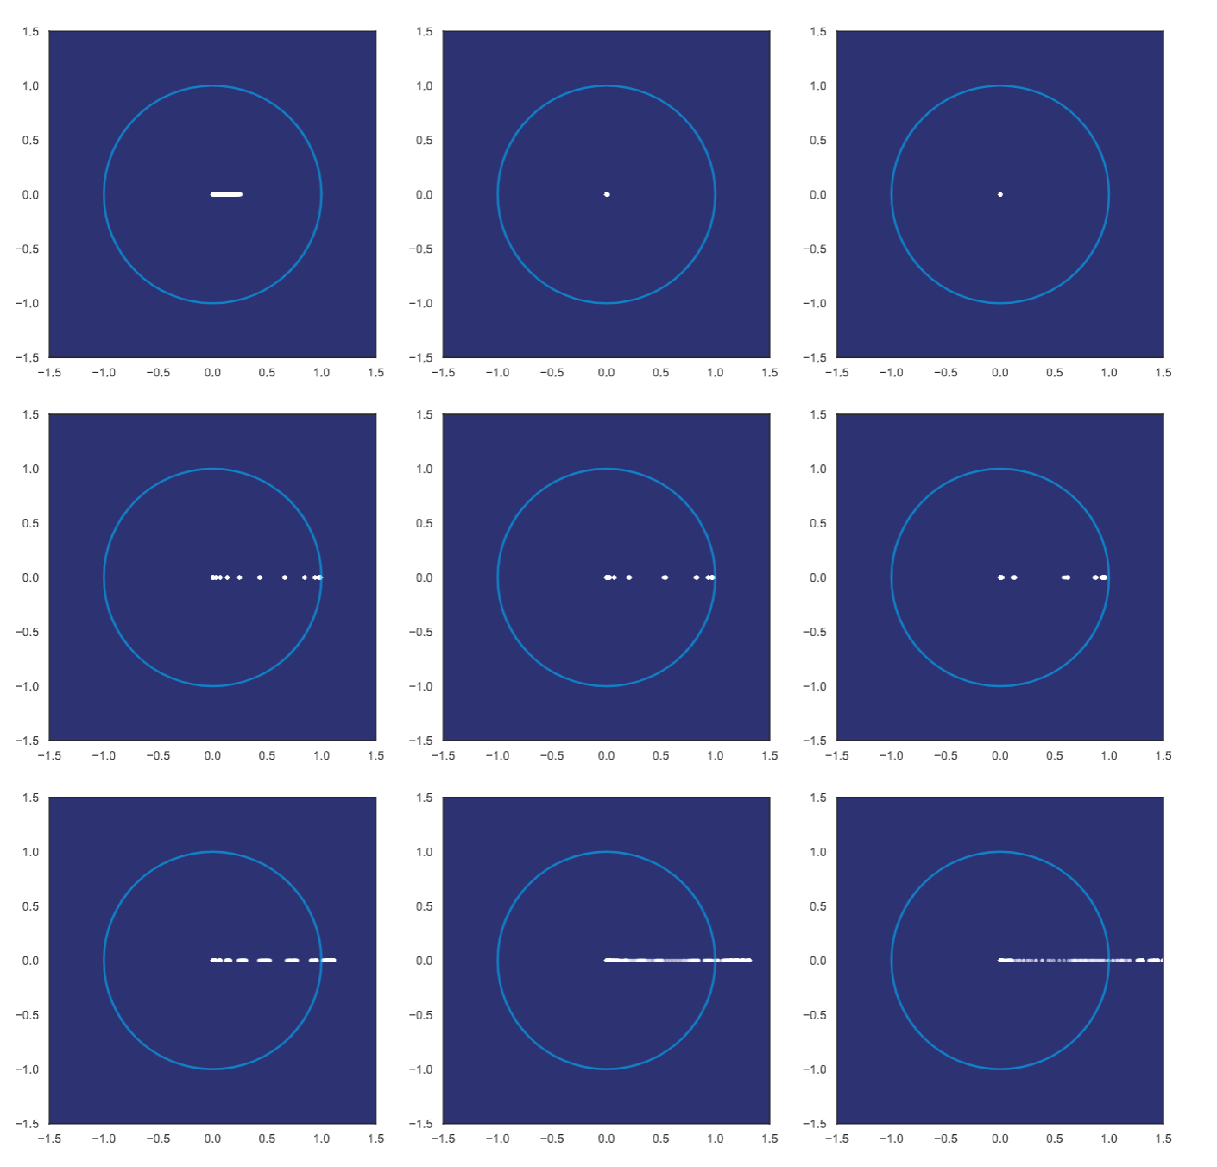
Dynamical Effects of Network Depth
Exponentially stable layers with
small eigenvalues imply
vanishing gradient problem
Network with energy conversion prevents gradient problems
Unstable layers imply exploding gradient problem
Jan Drgona, Aaron Tuor, Soumya Vasisht, Elliott Skomski, Draguna Vrabie, Spectral Analysis and Stability of Deep Neural Dynamics, arXiv:2011.13492
Notes:
The presentation I’m giving today is for a data-driven method for dynamics modeling.
We should care about this because people interact with and depend on complicated systems all the time.
Greater understanding of these systems can lead to outcomes which are
More energy efficient
Cost effective
Conducive to human life
Having an accurate model of a system enables scientific discovery,
Can provide critical information to support high stakes decisions in changing environments
Or to provide necessary information for predictive maintenance of high value equipment, avoiding costly and potentially dangerous equipment
Failures.
One of the most common and lucrative uses of systems models are for predictive control in manufacturing and other large scale enterprises.
I’m presenting a method today which bridges benefits of traditional physics-based modeling with more recent data-driven modeling using deep learning
Traditional physics-based modeling works very well and is widely used in many real world applications. However, it can’t always be applied to every situation.
missing information
incomplete awareness of the model state space.
limitations on the available operational data.
For large scale systems, not only are they difficult to model from first principles, it is also not always possible to simulate the system in real time.
Data-driven approaches for systems modeling are an alternative in these situations but can come with their own disadvantages.
Can take a lot of data to train and may behave unpredictably outside the distribution of training data in unobserved regions of the system state space.
In addition, modern neural network approaches don’t typically provide constraints enforcement within physically realizable and operationally safe bounds,

Slide 22
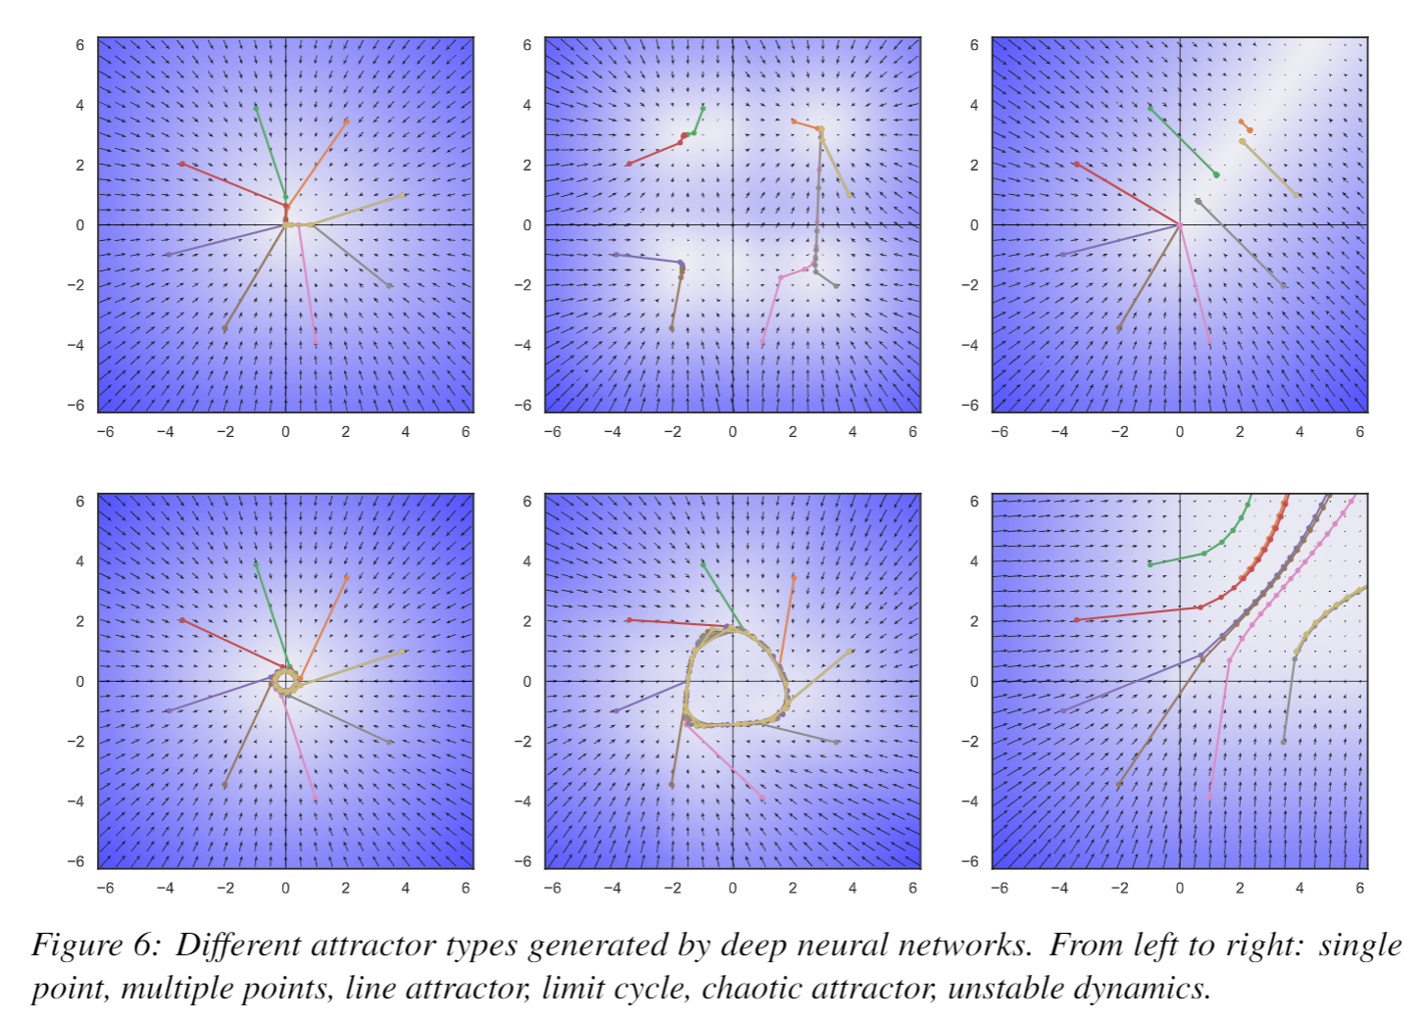
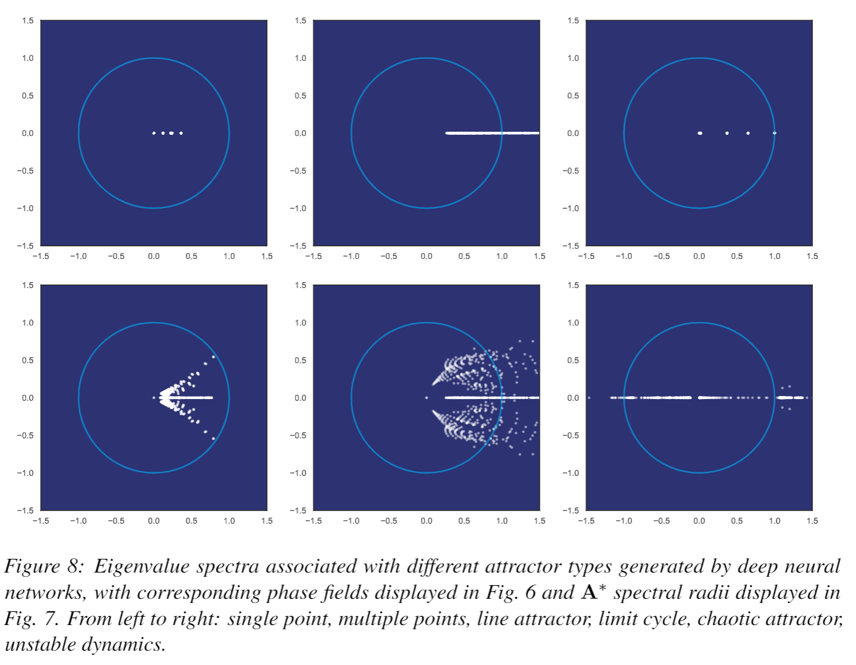
Attractors of Deep Neural Networks
Jan Drgona, Aaron Tuor, Soumya Vasisht, Elliott Skomski, Draguna Vrabie, Spectral Analysis and Stability of Deep Neural Dynamics, arXiv:2011.13492
Notes:
The presentation I’m giving today is for a data-driven method for dynamics modeling.
We should care about this because people interact with and depend on complicated systems all the time.
Greater understanding of these systems can lead to outcomes which are
More energy efficient
Cost effective
Conducive to human life
Having an accurate model of a system enables scientific discovery,
Can provide critical information to support high stakes decisions in changing environments
Or to provide necessary information for predictive maintenance of high value equipment, avoiding costly and potentially dangerous equipment
Failures.
One of the most common and lucrative uses of systems models are for predictive control in manufacturing and other large scale enterprises.
I’m presenting a method today which bridges benefits of traditional physics-based modeling with more recent data-driven modeling using deep learning
Traditional physics-based modeling works very well and is widely used in many real world applications. However, it can’t always be applied to every situation.
missing information
incomplete awareness of the model state space.
limitations on the available operational data.
For large scale systems, not only are they difficult to model from first principles, it is also not always possible to simulate the system in real time.
Data-driven approaches for systems modeling are an alternative in these situations but can come with their own disadvantages.
Can take a lot of data to train and may behave unpredictably outside the distribution of training data in unobserved regions of the system state space.
In addition, modern neural network approaches don’t typically provide constraints enforcement within physically realizable and operationally safe bounds,

Slide 23
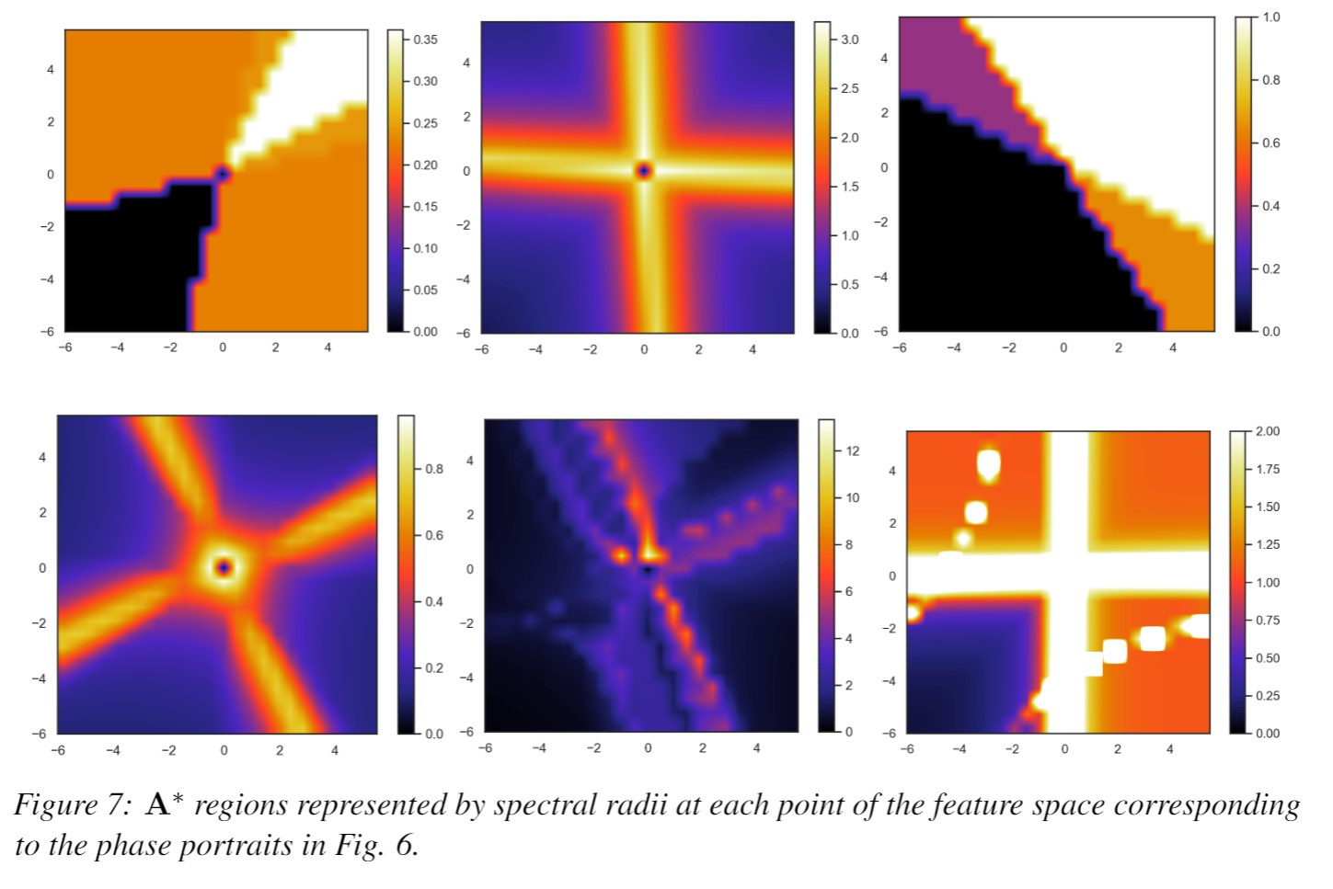
Attractors of Deep Neural Networks
Jan Drgona, Aaron Tuor, Soumya Vasisht, Elliott Skomski, Draguna Vrabie, Spectral Analysis and Stability of Deep Neural Dynamics, arXiv:2011.13492
Notes:
The presentation I’m giving today is for a data-driven method for dynamics modeling.
We should care about this because people interact with and depend on complicated systems all the time.
Greater understanding of these systems can lead to outcomes which are
More energy efficient
Cost effective
Conducive to human life
Having an accurate model of a system enables scientific discovery,
Can provide critical information to support high stakes decisions in changing environments
Or to provide necessary information for predictive maintenance of high value equipment, avoiding costly and potentially dangerous equipment
Failures.
One of the most common and lucrative uses of systems models are for predictive control in manufacturing and other large scale enterprises.
I’m presenting a method today which bridges benefits of traditional physics-based modeling with more recent data-driven modeling using deep learning
Traditional physics-based modeling works very well and is widely used in many real world applications. However, it can’t always be applied to every situation.
missing information
incomplete awareness of the model state space.
limitations on the available operational data.
For large scale systems, not only are they difficult to model from first principles, it is also not always possible to simulate the system in real time.
Data-driven approaches for systems modeling are an alternative in these situations but can come with their own disadvantages.
Can take a lot of data to train and may behave unpredictably outside the distribution of training data in unobserved regions of the system state space.
In addition, modern neural network approaches don’t typically provide constraints enforcement within physically realizable and operationally safe bounds,

Slide 24
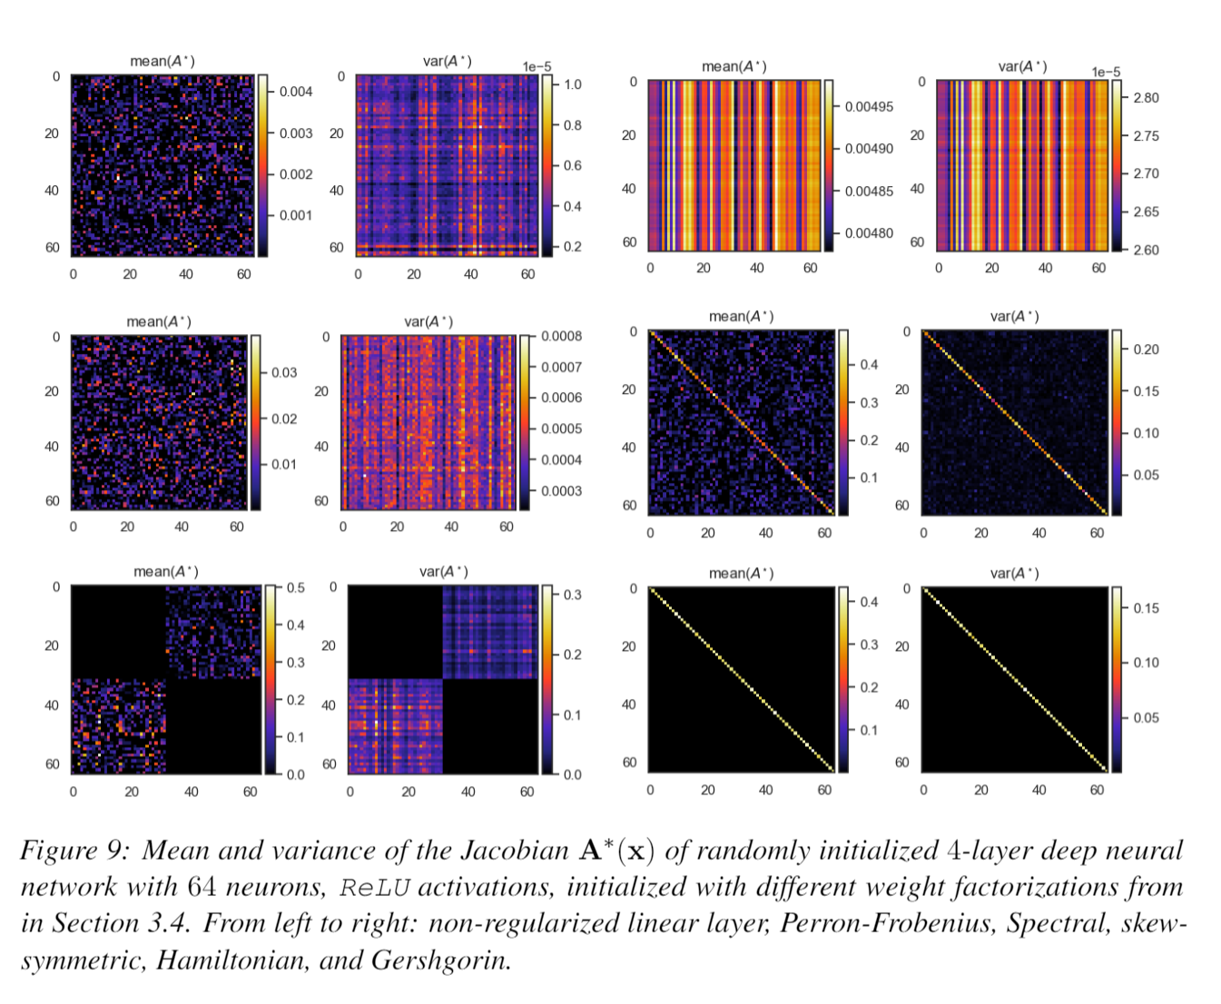

Jacobians of Deep Neural Networks
Notes:
The presentation I’m giving today is for a data-driven method for dynamics modeling.
We should care about this because people interact with and depend on complicated systems all the time.
Greater understanding of these systems can lead to outcomes which are
More energy efficient
Cost effective
Conducive to human life
Having an accurate model of a system enables scientific discovery,
Can provide critical information to support high stakes decisions in changing environments
Or to provide necessary information for predictive maintenance of high value equipment, avoiding costly and potentially dangerous equipment
Failures.
One of the most common and lucrative uses of systems models are for predictive control in manufacturing and other large scale enterprises.
I’m presenting a method today which bridges benefits of traditional physics-based modeling with more recent data-driven modeling using deep learning
Traditional physics-based modeling works very well and is widely used in many real world applications. However, it can’t always be applied to every situation.
missing information
incomplete awareness of the model state space.
limitations on the available operational data.
For large scale systems, not only are they difficult to model from first principles, it is also not always possible to simulate the system in real time.
Data-driven approaches for systems modeling are an alternative in these situations but can come with their own disadvantages.
Can take a lot of data to train and may behave unpredictably outside the distribution of training data in unobserved regions of the system state space.
In addition, modern neural network approaches don’t typically provide constraints enforcement within physically realizable and operationally safe bounds,

Slide 25




Nonlinearity of Deep Neural Networks
Identity
ReLU
Identity
ReLU
Sigmoid
SoftExponential
Sigmoid
SoftExponential
Notes:
The presentation I’m giving today is for a data-driven method for dynamics modeling.
We should care about this because people interact with and depend on complicated systems all the time.
Greater understanding of these systems can lead to outcomes which are
More energy efficient
Cost effective
Conducive to human life
Having an accurate model of a system enables scientific discovery,
Can provide critical information to support high stakes decisions in changing environments
Or to provide necessary information for predictive maintenance of high value equipment, avoiding costly and potentially dangerous equipment
Failures.
One of the most common and lucrative uses of systems models are for predictive control in manufacturing and other large scale enterprises.
I’m presenting a method today which bridges benefits of traditional physics-based modeling with more recent data-driven modeling using deep learning
Traditional physics-based modeling works very well and is widely used in many real world applications. However, it can’t always be applied to every situation.
missing information
incomplete awareness of the model state space.
limitations on the available operational data.
For large scale systems, not only are they difficult to model from first principles, it is also not always possible to simulate the system in real time.
Data-driven approaches for systems modeling are an alternative in these situations but can come with their own disadvantages.
Can take a lot of data to train and may behave unpredictably outside the distribution of training data in unobserved regions of the system state space.
In addition, modern neural network approaches don’t typically provide constraints enforcement within physically realizable and operationally safe bounds,

Slide 26

Ongoing Work and Vision

Slide 27
Ongoing Work and Vision
Open-source code
PSL: Python Systems Library
https://github.com/pnnl/psl
SLiM: Structured Linear Maps in Pytorch
https://github.com/pnnl/slim
NeuroMANCER: Neural Modules with Adaptive Nonlinear Constraints and Efficient Regularizations
https://github.com/pnnl/neuromancer
FY21 ongoing work
Uncertainty Quantification
User-friendly software API which follows the idioms of ML and Control
Comprehensive suite of physics-based priors and constraints
Theoretical guarantees: convergence, stability, constraints satisfaction

Slide 28
Research Ideas for DnC2S
T1 Modeling
Stability, invertibility and improved inference via regularizations
Deep Markov models
Deep POMDPs
Graph neural networks
Deep PGMs
T2 UQ
Robustness of deep neural nets and deep PGMs
Lipschitz constants
Reachability analysis
Sensitivity to perturbations
T3 Control
Probabilistic differentiable predictive control (DPC)
Closed loop stability and constraints satisfaction of POMDPs with neural networks
DPC as a policy optimization step for deep RL
T4 Continual Learning
Adaptive DPC policy updates with constraints and stability guarantees

Slide 29
Backup slides and references

Slide 30
Selected Reading: Dynamical Systems and Deep Learning
Differential equation solvers as part of DNN architectures
Ricky T. Q. Chen, et al., Neural Ordinary Differential Equations, 2018.
Eldad Haber and Lars Ruthotto, Deep Neural Networks motivated by Partial Differential Equations, 2018.
M. Raissi, et al., Multistep Neural Networks for Data-driven Discovery of Nonlinear Dynamical Systems, 2018.
Michael Poli, et al., TorchDyn: A Neural Differential Equations Library, 2020.
DiffEqFlux.jl – A Julia Library for Neural Differential Equations https://julialang.org/blog/2019/01/fluxdiffeq/
Using deep neural networks for solving differential equations
M Raissi, et al., Physics Informed Deep Learning: Data-driven Solutions of Nonlinear Partial Differential Equations, 2017.
Batuhan Güler, et al., Towards Robust and Stable Deep Learning Algorithms for Forward Backward Stochastic Differential Equations, 2019.
Deep neural operators for approximating differential equations
Zongyi Li , et al., Fourier Neural Operator for Parametric Partial Differential Equations, 2020.
Lu Lu, et al., DeepONet: Learning nonlinear operators for identifying differential equations based on the universal approximation theorem of operators, 2020
Notes:
Use cases for accurate systems models
Scientific discovery
Support strategic decisions in dynamic environments
Predictive maintenance
Predictive control
Physics-based modeling infeasible for many critical real-world systems
Missing information of underlying system dynamics
Incomplete awareness of model state-space
Limitations on available operational data
Sometimes difficult to get real time simulations
Purely data driven approaches are unsuitable
Poor sampling efficiency due to limited observational data
Black box models lack operational safety guarantees

Slide 31
Selected Reading: Dynamical Systems and Deep Learning
Deep learning for domain decomposition and Koopman operators
Bethany Lusch, et al., Deep learning for universal linear embeddings of nonlinear dynamics, 2018.
Enoch Yeung, et al., Learning Deep Neural Network Representations for Koopman Operators of Nonlinear Dynamical Systems, 2019.
Kathleen Champion, et al., Data-driven discovery of coordinates and governing equations, 2019.
Combining graph neural nets and physics constraints
Peter W. Battaglia, et al., Interaction Networks for Learning about Objects, Relations and Physics, 2016.
Alvaro Sanchez-Gonzalez, et al., Hamiltonian Graph Networks with ODE Integrators, 2019.
Sungyong Seo, Differentiable Physics-informed Graph Networks, 2019.
Combining deep learning and state space models
Olalekan Ogunmolu, et al., Nonlinear Systems Identification Using Deep Dynamic Neural Networks, 2016.
Rahul G. Krishnan, et al., Structured Inference Networks for Nonlinear State Space Models, 2016.
Syama Sundar Rangapuram, et al., Deep State Space Models for Time Series Forecasting, 2018.
Daniel Gedon, et al., Deep State Space Models for Nonlinear System Identification, 2020.
Notes:
Use cases for accurate systems models
Scientific discovery
Support strategic decisions in dynamic environments
Predictive maintenance
Predictive control
Physics-based modeling infeasible for many critical real-world systems
Missing information of underlying system dynamics
Incomplete awareness of model state-space
Limitations on available operational data
Sometimes difficult to get real time simulations
Purely data driven approaches are unsuitable
Poor sampling efficiency due to limited observational data
Black box models lack operational safety guarantees

Slide 32
Literature on Stability of Deep Neural Networks
Symmetric Structural Assumptions
Eldad Haber and Lars Ruthotto, Stable Architectures for Deep Neural Networks 2017.
Sam Greydanus, et al., Hamiltonian Neural Networks, 2019.
Miles Cranmer, et al., Lagrangian Neural Networks, 2020.
Lyapunov-based Stability Analysis: contraction towards stationary point
S. M. Richards, et al., The Lyapunov Neural Network: Adaptive Stability Certification for Safe Learning of Dynamic Systems, 2018.
Gaurav Manek, and Zico Kolter, Learning Stable Deep Dynamics Models, 2019.
Ya-Chien Chang, et al., Neural Lyapunov Control, 2019.
Spectral Constraints and Weight Regularizations
Jiong Zhang, et al., Stabilizing Gradients for Deep Neural Networks via Efficient SVD Parameterization, 2018.
Shaowu Pan, Karthik Duraisamy, Long-time predictive modeling of nonlinear dynamical systems using neural networks, 2018.
Eldad Haber, et al., IMEXnet: A Forward Stable Deep Neural Network. 2019
A. Tuor, J. Drgona, D. Vrabie, Constrained Neural Ordinary Differential Equations with Stability Guarantees, 2020.
Notes:
The presentation I’m giving today is for a data-driven method for dynamics modeling.
We should care about this because people interact with and depend on complicated systems all the time.
Greater understanding of these systems can lead to outcomes which are
More energy efficient
Cost effective
Conducive to human life
Having an accurate model of a system enables scientific discovery,
Can provide critical information to support high stakes decisions in changing environments
Or to provide necessary information for predictive maintenance of high value equipment, avoiding costly and potentially dangerous equipment
Failures.
One of the most common and lucrative uses of systems models are for predictive control in manufacturing and other large scale enterprises.
I’m presenting a method today which bridges benefits of traditional physics-based modeling with more recent data-driven modeling using deep learning
Traditional physics-based modeling works very well and is widely used in many real world applications. However, it can’t always be applied to every situation.
missing information
incomplete awareness of the model state space.
limitations on the available operational data.
For large scale systems, not only are they difficult to model from first principles, it is also not always possible to simulate the system in real time.
Data-driven approaches for systems modeling are an alternative in these situations but can come with their own disadvantages.
Can take a lot of data to train and may behave unpredictably outside the distribution of training data in unobserved regions of the system state space.
In addition, modern neural network approaches don’t typically provide constraints enforcement within physically realizable and operationally safe bounds,

Slide 33

Uncertainty Quantification: Methods
Monte-Carlo Dropout
Approximate variational inference via repeated sampling of NN predictions with dropout enabled at inference time
Method from “Dropout as a Bayesian approximation: representing model uncertainty in deep learning” by Gal and Ghahramani.
Graphic: “A frequentist approach to prediction uncertainty” by Yu Ri Tan
Notes:
Old:
Deep Gaussian Processes
Composes Gaussian Process models to represent hidden layers as distributions over functions
Conditional Invertible Neural Networks
Invertible architecture of cINNs allows for posterior estimation via latent space sampling

Slide 34


Uncertainty Quantification: Methods
Ensembling
Train K models with different random weight initializations, then aggregate predictions of all models
Models trained using Gaussian mixture objective
Method from “Simple and Scalable Predictive Uncertainty Using Deep Ensembles” by Lakshminarayanan et al.
Model 1
$$\left\{{\hat{μ}}_{1}^{\left(1\right)}, …, {\hat{μ}}_{N}^{\left(1\right)}\right\}, \left\{{\hat{σ}}_{1}^{\left(1\right)}, …, {\hat{σ}}_{N}^{\left(1\right)}\right\}$$
$$\left\{{\hat{μ}}_{1}^{\left(K\right)}, …, {\hat{μ}}_{N}^{\left(K\right)}\right\}, \left\{{\hat{σ}}_{1}^{\left(K\right)}, …, {\hat{σ}}_{N}^{\left(K\right)}\right\}$$
…
…
$$\left\{{\hat{μ}}_{1}^{}, …, {\hat{μ}}_{N}^{}\right\}, \left\{{\hat{σ}}_{1}^{}, …, {\hat{σ}}_{N}^{}\right\}$$
Model K
Predicted mean, std. deviation
from each model
Aggregated mean, std. deviation
Notes:
Old:
Deep Gaussian Processes
Composes Gaussian Process models to represent hidden layers as distributions over functions
Conditional Invertible Neural Networks
Invertible architecture of cINNs allows for posterior estimation via latent space sampling

Slide 35

Uncertainty Quantification: Methods
Bayesian Neural Networks
Each weight of a NN defined as a distribution whose parameters are learned by variational inference
Method from “Weight uncertainty in neural networks” by Blundell et al.
Figure from Blundell et al., 2015. A standard neural network (left), a Bayesian neural network (right).
Notes:
Old:
Deep Gaussian Processes
Composes Gaussian Process models to represent hidden layers as distributions over functions
Conditional Invertible Neural Networks
Invertible architecture of cINNs allows for posterior estimation via latent space sampling

